Slide 1

Tharros
The game

Slide 2
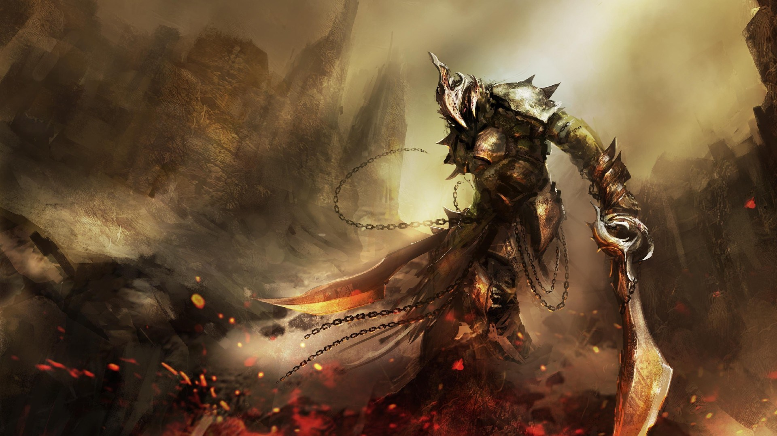
“Be strong, saith my heart; I am a soldier; I have seen worse sights than this.” ― Homer, The Odysseys

Slide 3
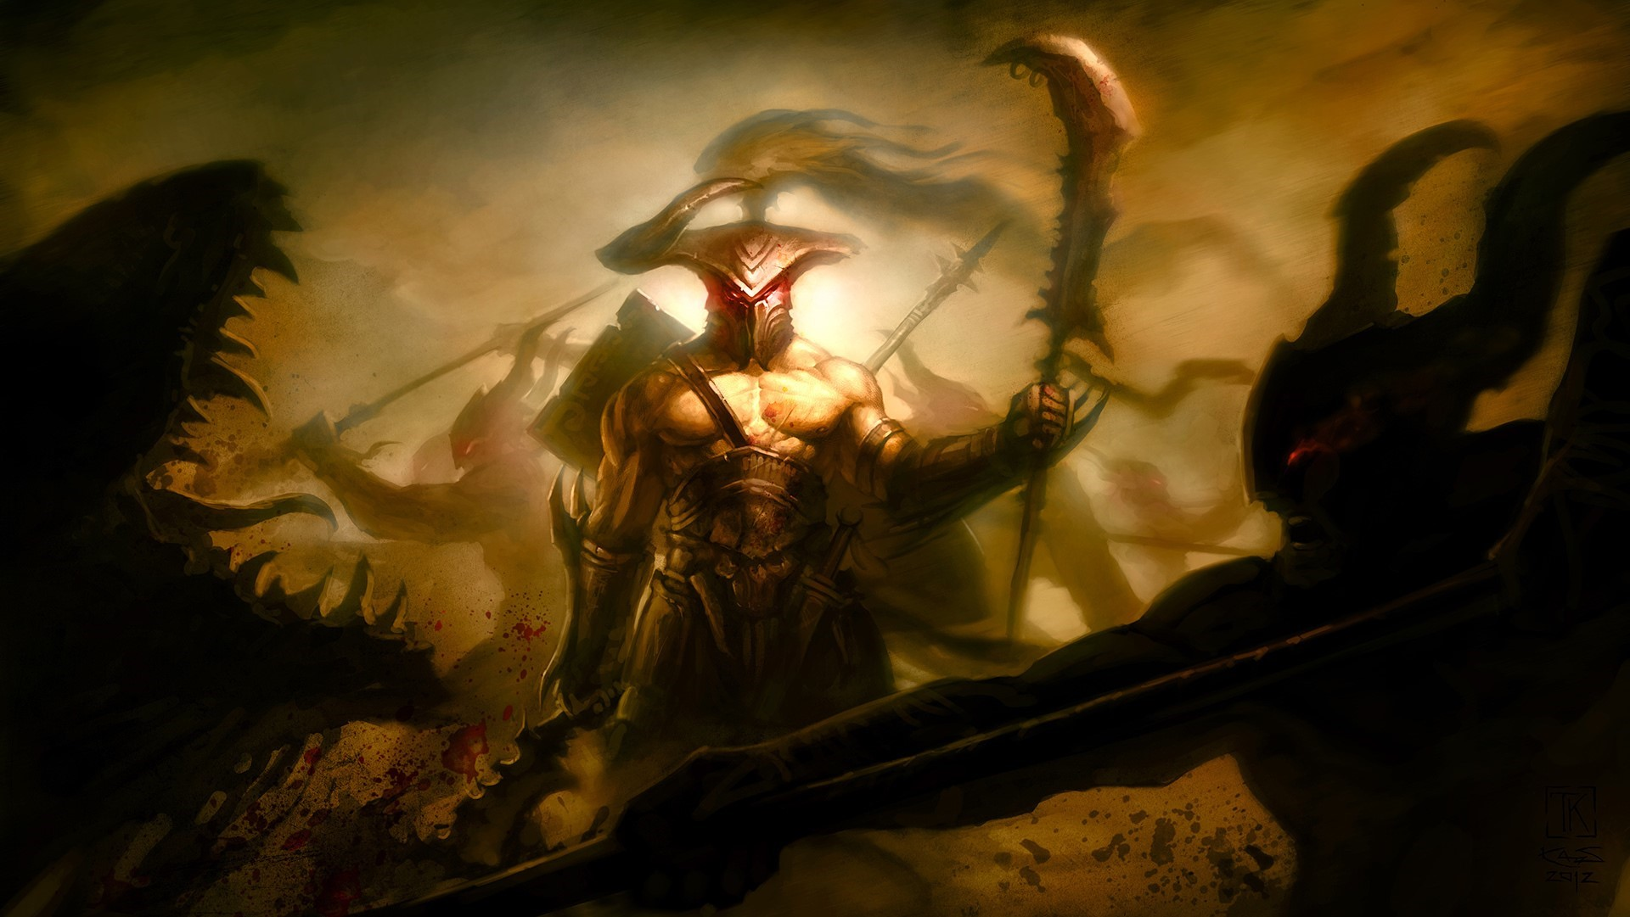
The mythology of the Odyssey:
The origin of the story
Overview of the story
What inspired the game

Slide 4

Development process:
The team
The ideology
The process

Slide 5
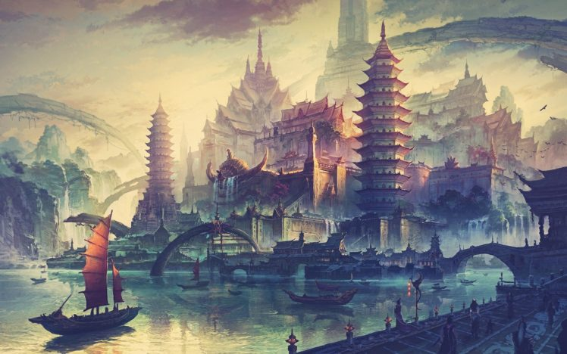
Gameplay demonstration:

Slide 6
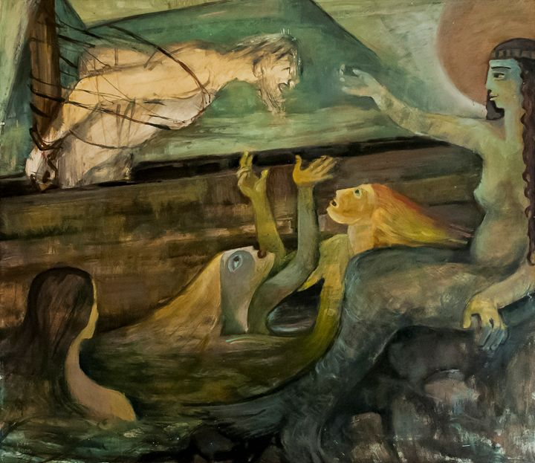
Game features:
Interactive story line
Text-based picture design
Audio design
Price point

Slide 7
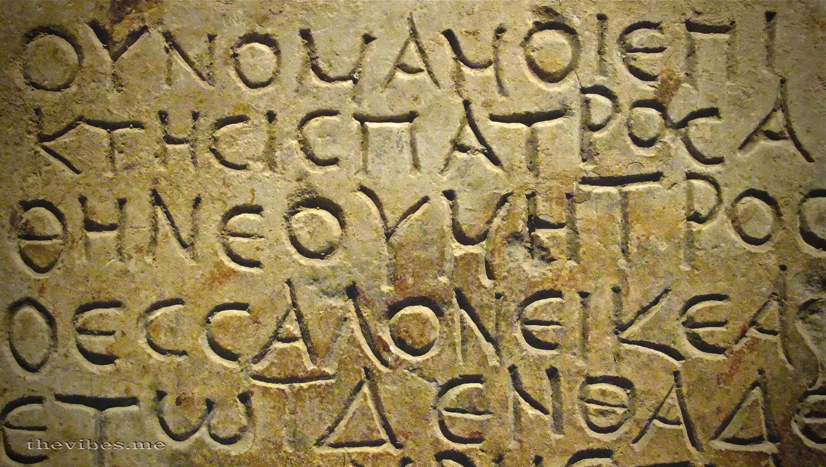
Questions?

Slide 8
References:
For the pictures:
https://thevibes.me/
http://s30899485658.mirtesen.ru/
https://www.artpal.com/buy/paintings-prints/fantasy-mythology/mythology/greek/?i=96453-8
https://wallpapersin4k.net/wallpaper/252442
http://www.anypics.ru/64772-voin-art-monstry-krov-pole-brani-past-bitva-rana.html
https://www.shutterstock.com/

